Slide 1
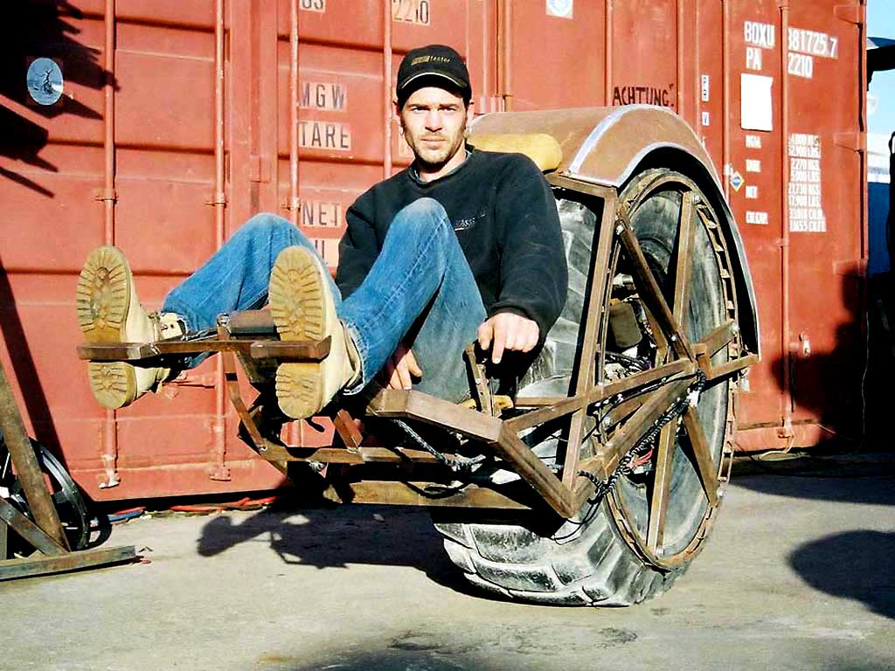
Requirements
http://www.flickr.com/photos/buglugs/1416652608/sizes/o/

Slide 2
Just Right? Or “all kinds of wrong”?
It depends on the system’s purpose.
http://www.flickr.com/photos/buglugs/1416652608/sizes/o/

Slide 3
Requirements
Requirements state the purpose of the system
Very helpful for
Communicating with customers and co-workers
Keeping track of everything that needs to get done
Helping you and the customer decide what really needs to get done, anyway
Hint: customers often don’t know what they really need!
Discussing requirements helps them to understand their needs.

Slide 4
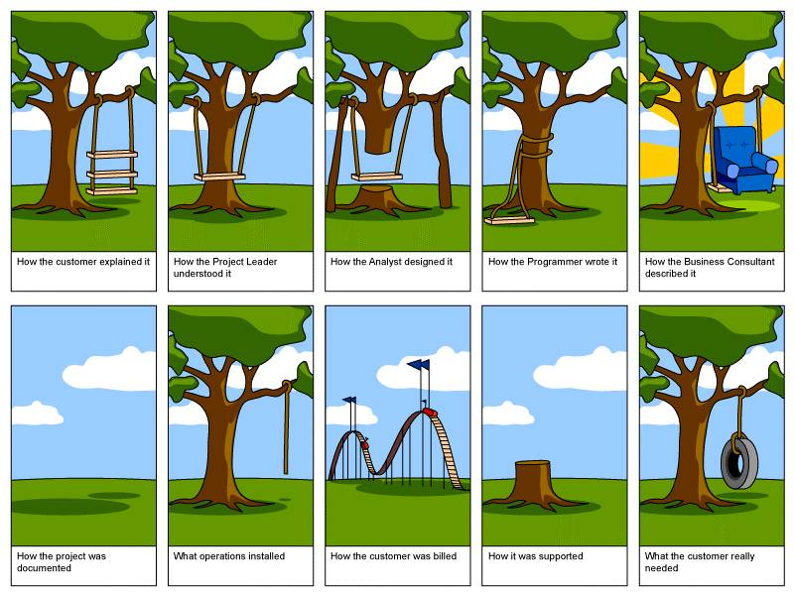
Why Bother? The Importance of Getting it Right

Slide 5
Requirements analysis / elicitation
Ways to figure out what the system should do:
Get the customers to write down what they want
Talk with customers and make some diagrams
Watch users in “daily life” to see what they need
Look up the requirements from a standards body
Gather with customer & users to discuss, argue, and negotiate
Any combination, variation, or extension of the above

Slide 6
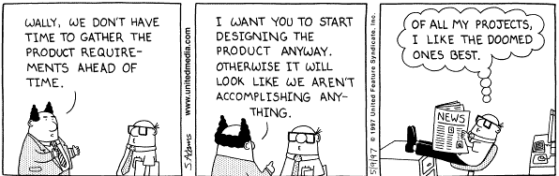
What happens when you don’t do it right

Slide 7
Standish survey of software development projects (1995)
Factors Reported for Failure
13.1% - Incomplete Requirements
10.6% - Lack of Resources
9.9 % - Unrealistic expectations
9.3 % - Lack of Executive support
8.7 % - Changing requirements and specification
8.1 % - Lack of Planning
7.5 % - System no longer Needed
Notes:
39.8%

Slide 8
Good requirements are…
Correct: They have to say the right things.
Consistent : They can’t contradict each other.
Unambiguous: Each must have 1 interpretation.
Complete: They cover all the important stuff.
Relevant: Each must meet a customer need.
Testable: There must be a way to tell if they are satisfied.
Traceable: There must be a way to determine their origin.

Slide 9
Typical parts of requirements documentation
Functional requirements
Unstructured text
Use cases
Non-functional requirements
Unstructured text
Fit criteria
Specifications
Logic (operational vs. descriptive), temporal logic
Algebraic specifications
Diagrams
Class diagrams and entity-relationship diagrams
Dataflow, sequence, and state diagrams

Slide 10
Typical parts of requirements documentation
Functional requirements
Unstructured text
Use cases
Non-functional requirements
Unstructured text
Fit criteria
Specifications
Logic (operational vs. descriptive), temporal logic
Algebraic specifications
Diagrams
Class diagrams and entity-relationship diagrams
Dataflow, sequence, and state diagrams

Slide 11
Functional requirements: tell what the system should do
Can be written as unstructured text
Can be written from
External viewpoint (requirements definition)
System viewpoint (requirements specification)
Can be written as structured use cases

Slide 12
Unstructured text… external vs. system viewpoint
A requirements definition is stated from the viewpoint of somebody outside the system:
The system is a black box with some interface
The emphasis is on the role of the system
A requirements specification is stated from the viewpoint of somebody inside the system:
The environment is accessed via inputs & outputs
The emphasis is on how the system works

Slide 13
External vs. system viewpoint, example
External, stated from the viewpoint of somebody outside the system boundary:
e.g.: “The sprinkler never runs on rainy days”
Internal, stated from the viewpoint of somebody inside the system boundary:
e.g.: “The controller will not engage the water pump any time the ambient water sensor is triggered.”

Slide 14
Which of these are definitions? Which are specifications?
“If the system detects that the drawbridge is down at noon, then it will raise the bridge for 10 minutes by activating the lift actuators.”
“The bridge will open 12:00-12:10pm daily.”
“Web sites will be spidered every day”
“The pilot can retract the landing gear by pressing a button”
“When it receives an http DELETE operation, the system will mark the record as deleted.”

Slide 15
Use cases: structured requirements definitions
Each use case describes an activity supported by the system
Put another way, each use case describes a way to use the system
Each use case is like a “bundle of scenarios” that are all the same except for very minor details
Being structured, use cases are a little more formal and precise than unstructured text.

Slide 16
What’s in a (basic) use case?
Use case name: succinct and meaningful
Actor: who “does” the activity?
Preconditions: what is true before the activity?
Postconditions: what is true after the activity?
Flow of events: what steps do the actor and the system perform during the scenario?

Slide 17
Example Use case #1: Report repression
Actor: Citizen in repressive country
Preconditions:
User has a cell phone connectivity
User has Twitter account
Postconditions:
System has recorded information about a repressive event, including location & details

Slide 18
Example continued… Use case #1: Report repression
Flow of events:
User posts a tweet giving city & country name, description of repression, and tag #repression
System periodically retrieves all #repression tweets via Twitter API
System parses tweet and geocodes locations
If location is ambiguous, system asks user to clarify (UC #2: Clarify tweet)
System records location and event in database

Slide 19
Example Use case #2: Clarify tweet
Actor: ?
Preconditions: ?
Postconditions: ?
Flow of events?

Slide 20
Example Use case #2: Clarify tweet
Actor: Citizen in repressive country
Preconditions:
- User sent a tweet with ambiguous location
Postconditions:
- System has gotten clarification of location

Slide 21
Example continued… Use case #2: Clarify tweet
Flow of events:
System replies to user, asking for user to clarify the city and country of the initial post
User edits and re-tweets the original message
Repeat above two steps until system can determine the location of the tweet

Slide 22
Sometimes, use cases are drawn in a cute (?) little diagram
UC#1: Report repression
UC#2: Clarify tweet
Repressed citizen
UC#3: View reports
Concerned public
UC#3a: View on map
UC#3b: View as RSS feed

Slide 23
Non-functional requirements
Describe how well the system should do stuff
Can be written as unstructured text
Often written in terms of fit criteria
Exactly how good does the system need to be?
Tightly related to important quality attributes
Fit criteria should not be “imagined”, but instead driven by customer needs

Slide 24
Non-functional requirements usually relate to quality attributes
The quality attributes of great software:
Reliability
Efficiency
Integrity
Usability
Maintainability
Testability
Flexibility
Portability
Reusability
Interoperability
Notes:
Reliability
Efficiency
Integrity
Usability
Maintainability

Slide 25
Examples: What quality attribute?
“The system must ask for tweet clarification within 5 minutes.”
so the user is probably still online
“The drawbridge must rise within 1 minute.”
so traffic stops only ~ 5 minutes (1+1+ 3 for ship)
“At least 95% of the code must be Java.”
because porting such applications to Linux has proven to cost only $XXXX in the past

Slide 26
Typical parts of requirements documentation
Functional requirements
Unstructured text
Use cases
Non-functional requirements
Unstructured text
Fit criteria
Diagrams
Class diagrams and entity-relationship diagrams
Dataflow, sequence, and state diagrams

Slide 27
Overview of diagrams
Use case diagram: shows supported activities
UML class and entity-relationship diagrams: show entities, attributes, relationships
Dataflow diagram: shows flow of information
Message sequence diagram: shows flow of control
State chart: shows change over time

Slide 28
Problems with unstructured text /Natural Language
Lack of clarity
Readers and writers must interpret them in the same way
Precision is difficult without making the document hard to read
Requirements confusion
Functional and non-functional requirements tend to be mixed
Requirements amalgamation
Several different requirements may be expressed together
Over-flexibility
Same thing may be said in many different ways

Slide 29
Example: Database Requirement
The database shall support the generation and control of configuration objects; that is, objects which are themselves groupings of other objects in the database. The configuration control facilities shall allow access to the objects in a version group by the use of an incomplete name.
Problem: requirements includes both conceptual and detailed information
Describes the concept of configuration control facilities
Includes detail that objects may be accessed using incomplete name

Slide 30
Example: Specification Fragment for a Word-Processor
Selecting is the process of designating areas of the document that you want to work on. Most editing and formatting actions require two steps: first you select what you want to work on, such as text or graphics; then you initiate the appropriate action.
can an area be scattered?
Notes:
ambiguity

Slide 31
Example: Editor Grid Requirement
… Grid facilities To assist in the positioning of entities on a diagram, the user may turn on a grid in either centimetres or inches, via an option on the control panel. Initially, the grid is off. The grid may be turned on and off at any time during an editing session and can be toggled between inches and centimetres at any time. A grid option will be provided on the reduce-to-fit view but the number of grid lines shown will be reduced to avoid filling the smaller diagram with grid lines.
Problem: grid requirement mixes three different kinds of requirement
Conceptual functional requirement (the need for a grid)
Non-functional requirement (grid units)
Detailed-functional UI requirement (grid switching)

Slide 32
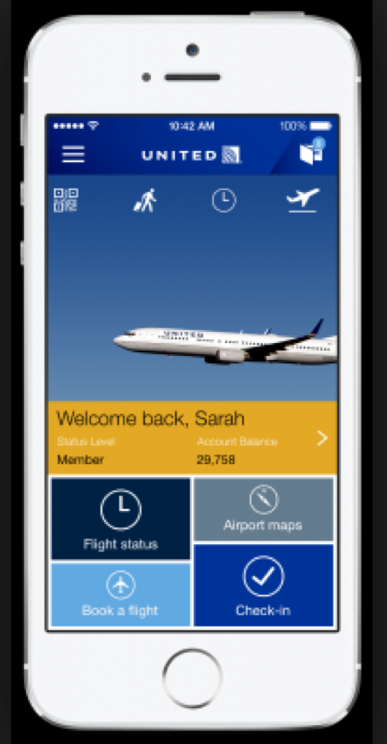
Class Exercise
Identify stakeholders and their goals for an example application:
Mobile application for airline reservations and check-in.
Direct Stakeholders
Indirect Stakeholders

Slide 33
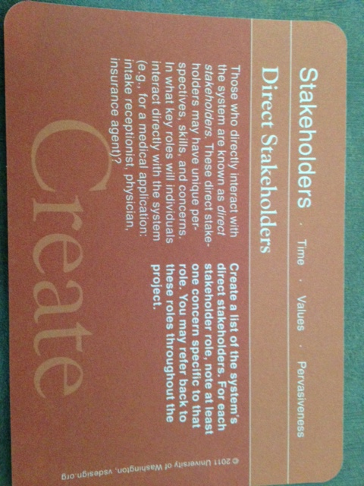

Slide 34
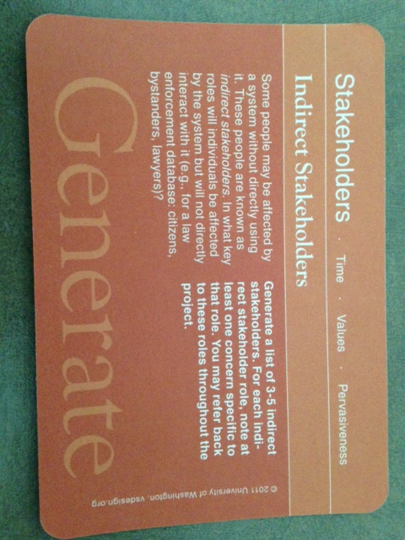

Slide 35
What’s next for you?
Vote online for vision statements:
Which visions capture your imagination???
No, you cannot vote for your own.
You can vote for more than one (for a few – max 5)
Voting through Google Forms - instructions will be announced soon…

Slide 36
If you want to be proactive!!!
HW1 is due next Saturday (10/10) at 11:59 pm.
Teams assigned by Monday (will exhort your fabulous TAs to do it sooner if possible!)
Prepare to meet your customer (vision statement provider) Tuesday! If not earlier
Start with obtaining use cases

